Slide 1
DCF255
Lecture 1 | Introduction to Course and Data Communication Networks

Slide 2
Agenda
Overview of Course and Expectations
Understanding basic terminology – Data Communications v Networking
Why do programmers need to understand data communications?
Brief history of Data Communication Networks
Notes:
May require more than one slide

Slide 3
Course Overview
Brief description of DCF255 Expectations

Slide 4
Course Description
DCF255
Weekly addendum is available under Course Information Link under DCF255 course on My Seneca
Course Web Site
MySeneca

Slide 5
Course Evaluation
Lab Assignments: (8) 1.875 each 15%
Assignments: 2
1 individual assignment 5%
Group Assignment 10% Total 30% Working in groups of 3 students each group will provide a 4-6 page report on an Internet protocol. The report will be submitted using BB portfolio tool as well as a hard copy of the report
Quizzes: (best 8 out of 9) 35%
Test 1 – weeks 1-5 (Data Comm) 15%
Final Exam – weeks 7-11 (Networking) 20% Total 70%
Grand Total 100%
Note: To obtain a credit: Students must pass the Final exam with 50% or more and weighted average of 50% or more on all tests (that includes quizzes as well). Satisfactorily complete all labs and assignments and achieve a grade of 50% or more on the overall course

Slide 6
Success Factors Summary
Complete weekly assigned task
Review lectures and notes
Make notes from Word document file
Come prepared to ask questions in during online session (timings will be shared prior to the class weekly)
Complete course work on time
Write all the quizzes and study hard to do your best
Submit lab assignments before due date (In case of late submission penalty of 0.1 mark from total marks obtained)
Participate in weekly discussions or post your queries or questions via Discussion Board on under DCF255 on My Seneca
A complete DCF255 course navigation guide is available under Getting Started link on the left hand side menu

Slide 7
Terminology
Data Communications v Networking

Slide 8
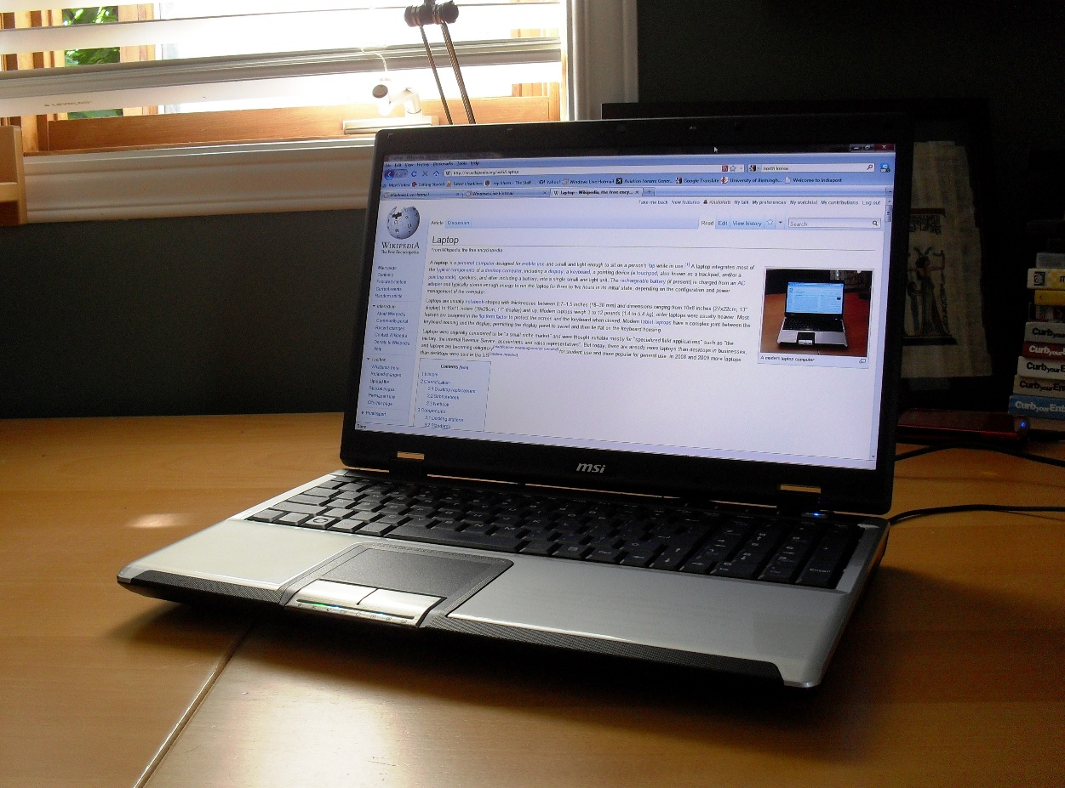
Terminology
A computer is a programmable machine that can perform various computations, store data, and create documents
It follows a set of prerecorded instructions called a program.
The data generated or stored by the computer is a collection of zeros and ones.

Slide 9
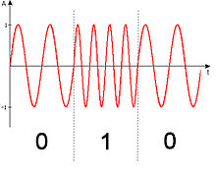
Terminology
Data communications :
“is the sending of signals that represent zeros and ones over a point-to-point circuit between two computers.”

Slide 10

Terminology
Networking :
“begins when point-to-point circuits are joined together into a collection of computers for the exchange information and the sharing of resources.”

Slide 11
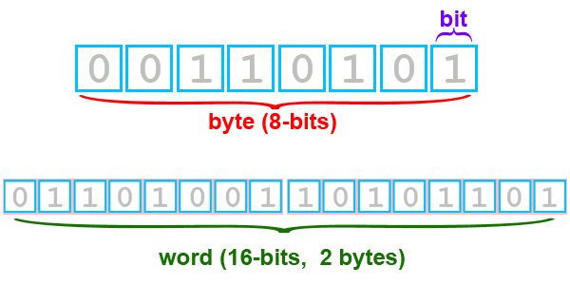
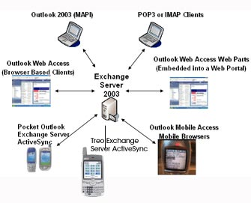
Summary
Data Communications is concerned with bits and bytes of digital data getting from point A to point B across a direct link.
Networking is concerned with the interoperability and exchange of information among applications

Slide 12
Data Communications v Networking
I’m a programmer, why do I need to know about data communications?

Slide 13



1. Programmers need to know what happens in the network cloud to write useful applications.
Early days of networking not necessary for programmers to understand networking
Today programming and networking “converging”
Program code and data no longer on same machine. Now stored on different machines.
To write effective programs, programmers need to understand how the network is structured
Networking personnel must understand programming in order to set up the ACLs properly
?

Slide 14
Example: How many bits and how long to transport one 81/2 X 11 page of information?
10 characters X 6.5 inches X 27 lines = 1,755 characters
Using UniCode encoding: 1755 characters X 16 bits = 28,080 bits per page
How long will it take to transmit?
Dialup @ 56000 bps = 28,080 / 56000 =0.5 seconds approximately
4G @ 1.5Mbps = 28,080 / 1500000 = 0.019 approximately
?
To properly design a mobile application the programmer must be able to estimate the total amount of data to be transmitted within a particular time period (seconds, minutes, hours) to know how much throughput is needed by the network

Slide 15
Network speed is affected by:
Weather – rain or snow can slows the network
Bandwidth is share so the more users the slower the network
Distance from Cell tower – the further way the slower the network
Amount of Network Congestion – latency at towers and routers slows the network
?
By understanding the layers of abstraction below the network level you will be better able to write and to troubleshoot a network application. The goal is for you to be a more productive programmer.

Slide 16
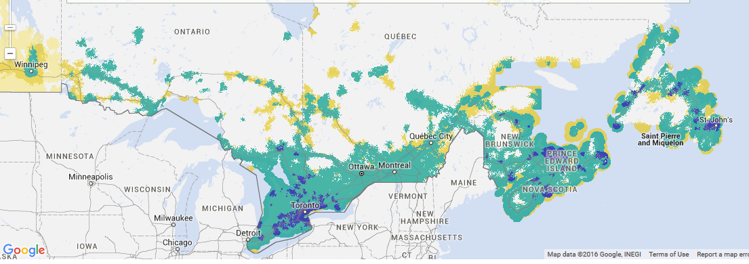
Canadian Network Speeds Summary
Legend
Notes:
The majority of rural areas in Canada still have dial up speeds. Don’t forget this!!

Slide 17

2. Programmers must also know how hackers can exploit applications
Writing secure applications means you understand how hackers can exploit applications for malicious purposes
Programmers need to understand how hackers will try and use the application in ways it was not intended.
Buffer Overflow, SQL infection attacks are examples where the programmer was overly trusting of user input.

Slide 18
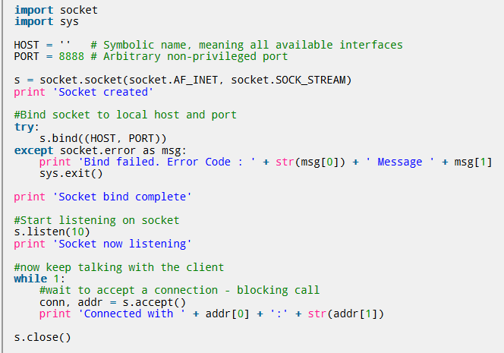
Programmers must also know how hackers can exploit applications
Everyone knows about IP address such as 192.168.0.1, but as programmers, we need to understand the process of using sockets in applications and how application data can be changed by malicious individuals.
A good mobile application will have a “choke-point” where all input data will be checked to ensure the data is in the format and length expected by the application.
And if not, how to sanitize the input using stored procedures or regular expressions
A common exploit is MAC spoofing or ARP Cache poisoning
Notes:
We will talk more about MAC spoofing or ARP Cache poisoning in later lectures.
On a local area network, the IP address is not used, only the 48bit physical or Ethernet address. The ARP Cache maintains a mapping of IP addresses to Ethernet addresses, like DNS keeps a mapping of domain names to IP addresses. If an attack can over-write the Ethernet addresses of two or more victims he/she can place themselves in the middle of a conversation.

Slide 19
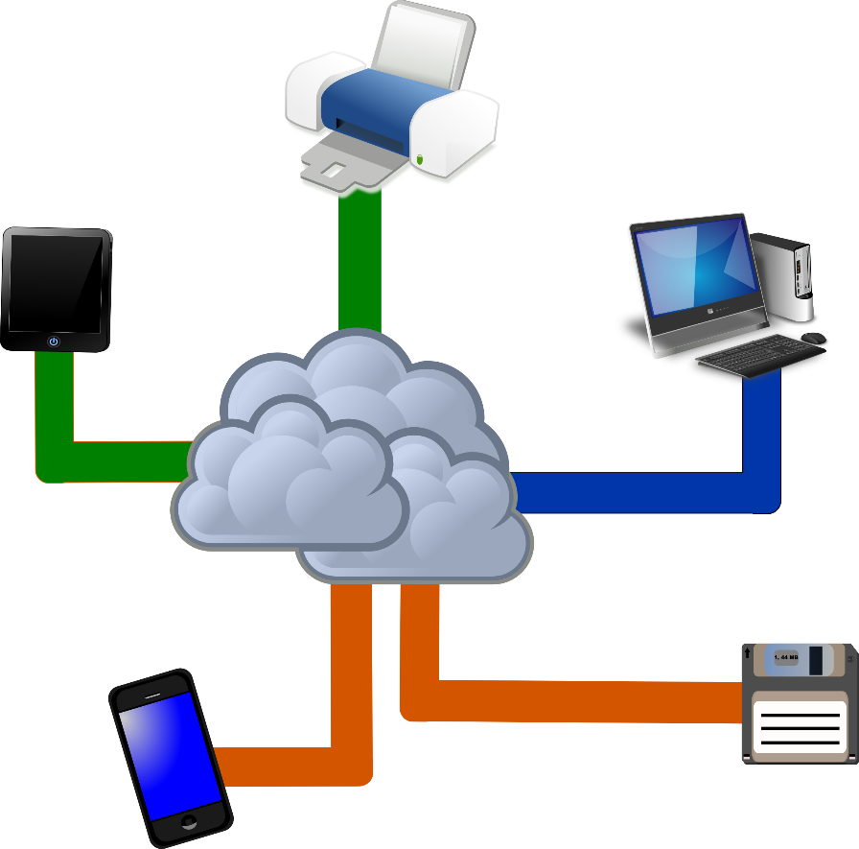
3. John Gage has described the IT environment of today as “The network is the computer.”
The Cloud is now a development platform
The cloud can run programs and store data just like the computer
And through virtualization the cloud is a network of thousands of computers with unparalleled processing power.
Notes:
By network he meant that the cloud is now our computer. Let’s take a brief history of Communication Networks to understand how we got to this stage.

Slide 20
Communication Networks
A Brief History

Slide 21
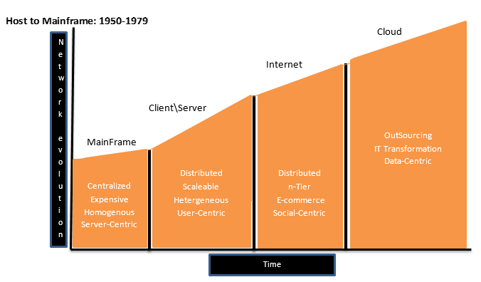
Host to Mainframe: 1950-1979
Mainframe is a large powerful unit
Centralized processing, meaning that the data and executable code ran on the same machine
Mainframes can only “talk” to dumb terminals, not PCs
Very expensive, and usually hardware and software sold from same vendor

Slide 22
Client-Server: 1980-1990
Client-Server architecture developed from the marketing of the PC
Processing was distributed, meaning that the code and data did not have to be on the same computer.
Led to a heterogeneous system where hardware and software not provided from same vendor
Client-Server more affordable and led to 2-Tier programming. Client interface front end with a server processing back end

Slide 23
Internet: 1991-2009
Led to n-Tier Programming where the client interface, business logic, and data are stored on different machines
Led to a more heterogeneous system because vendor’s started producing “middleware” to make software and hardware from different vendors work together
Greatly lowered the cost of LAN networks

Slide 24
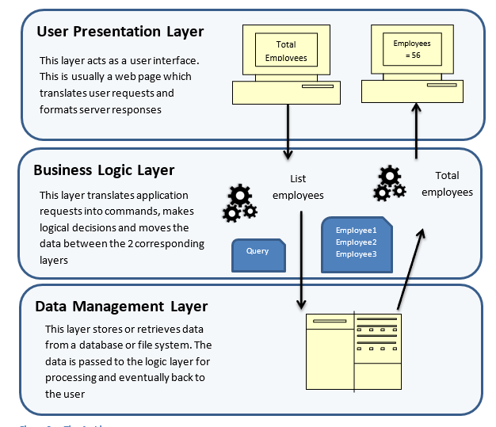
n-Tier Programming

Slide 25
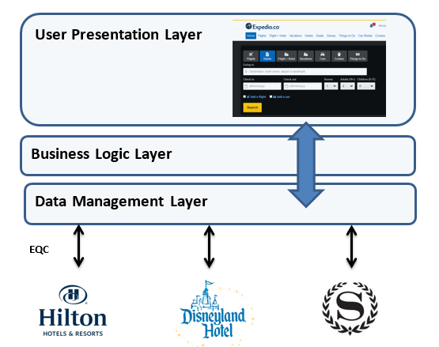
Expedia Example:
Originally developed by Microsoft as a research project in n-Tier Programming Expedia is now a premier travel provider
Hotels have time sensitive inventory for example a block of rooms which sell for $170 a night, but have not sold and its early afternoon.
Hotels use Expedia’s Quick Connect software to list that block of rooms available for sale directly to Expedia’s Data Management Layer. Expedia buys these rooms, e.g. $95
When you go on the Internet to search for deals, Expedia’s User Presentation Layer displays the rooms which Expedia resells to you e.g. $120-$130

Slide 26
Cloud-Computing: 2010- present
Cloud computing is an extensive of Client-Server architecture
Cloud is “data-centric” allowing users to connect to the network with a smart phone or computer and access information from anywhere
Cloud computing increases the use of “out-sourcing” for software (SaaS), infrastructure (IaaS), or platform (PaaS) services
Cloud computing will revolutionize how IT handles network services, fewer personnel will be needed
Cloud has thousands of virtual clients which can process data faster than in-house systems. This will change the nature of business systems, such as buying and, selling

Slide 27
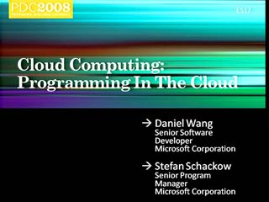
Cloud and Programming
The Cloud has now become a development platform,Microsoft Azure, Google’s Cloud
. The 15th version of MSOffice is fully compatible with the cloud to allow users to use the cloud as their local PC.
Developers are rewriting existing programs to run on clouds
Popular programming languages for cloud are: SQL, Python, R Math, Erlang, XML Data, Clojure Math Language, GO,GFM domain, RUBY, PHP, JAVA etc.
Joseph Hellerstein has developed a new language called BLOOM which will help programmers write complex data-centric cloud applications.

Slide 28
Summary
Programmers should understand data communications in order to be better programmers, designing useful mobile applications that are consistent with network speeds and throughput.
Programmers should understand data communications in order to know how hackers can take advantage of programming mistakes. This will help programmers to write more secure applications
Lastly, programmers should understand data communications because the world of networking and programming is forever changed with the advent of client-server architecture and cloud computing. The latter is changing the nature of programming and business.

